Slide 1

Implement a* Algorithm to find optimal path in map
18101064 – Md. Sohanuzzaman Soad

Slide 2
CONTENTS
INTRODUCTION
OBJECTIVE
DESIGNED MAP
SEARCH TREE
RESULTS ANALYSIS
CONCLUSION

Slide 3
Introduction
Nowadays most of the time in our daily life we use Google Map as a Navigator System. Google map suggest us shortest path when we choose our current location and destination. This shortest path is generated based on distance of source and destination.
A* is an informed search algorithm, or a best-first search, meaning that it is formulated in terms of weighted graphs: starting from a specific starting node of a graph, it aims to find a path to the given goal node having the smallest cost (least distance travelled, shortest time, etc.).
Specifically, A* selects the path that minimizes f(n)= g(n) + h(n)

Slide 4
objective
In this project our objective is implement a small version of google maps with specific source and destination location with some nodes between source and destination.

Slide 5
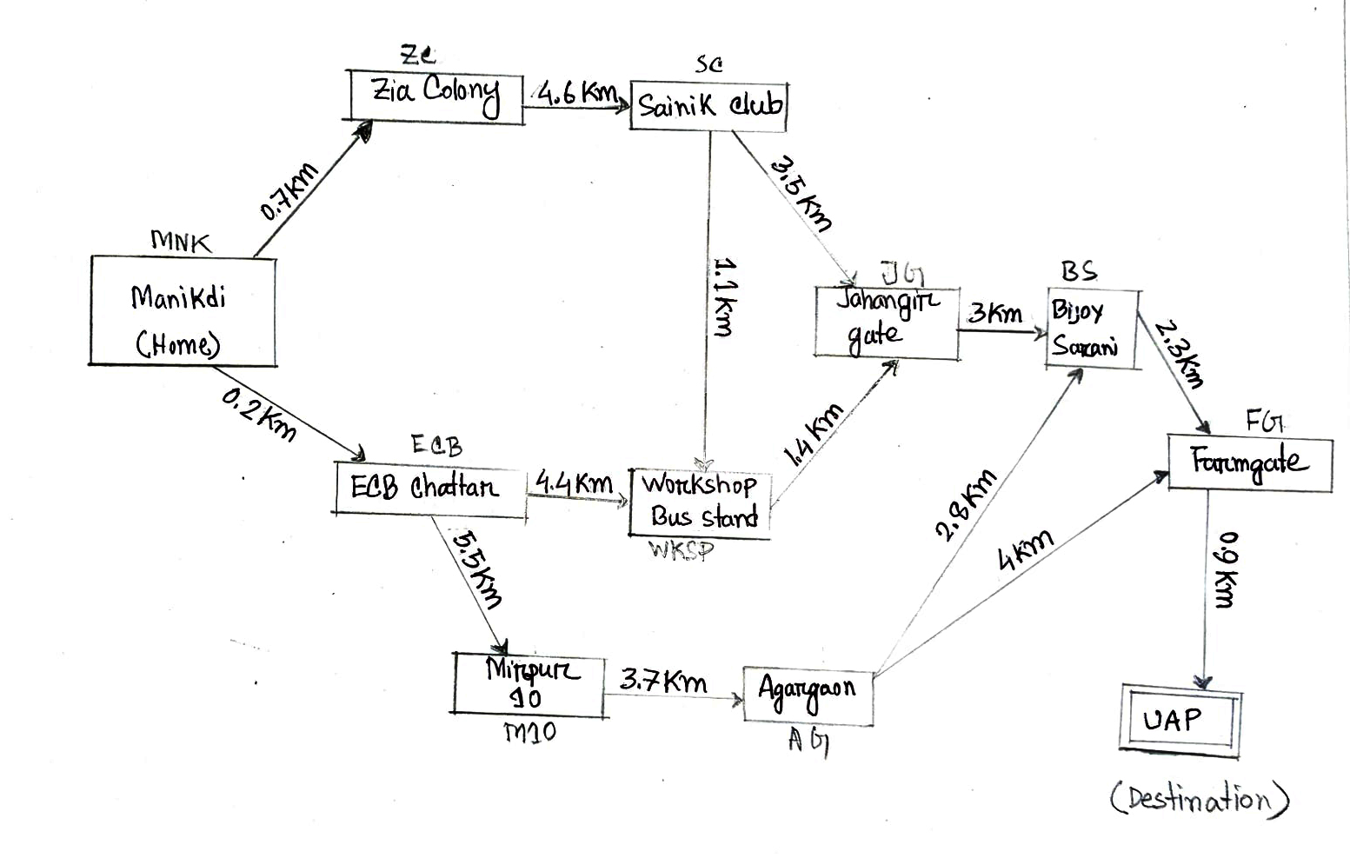
DESIGNED MAP
Path : Home to UAP

Slide 6
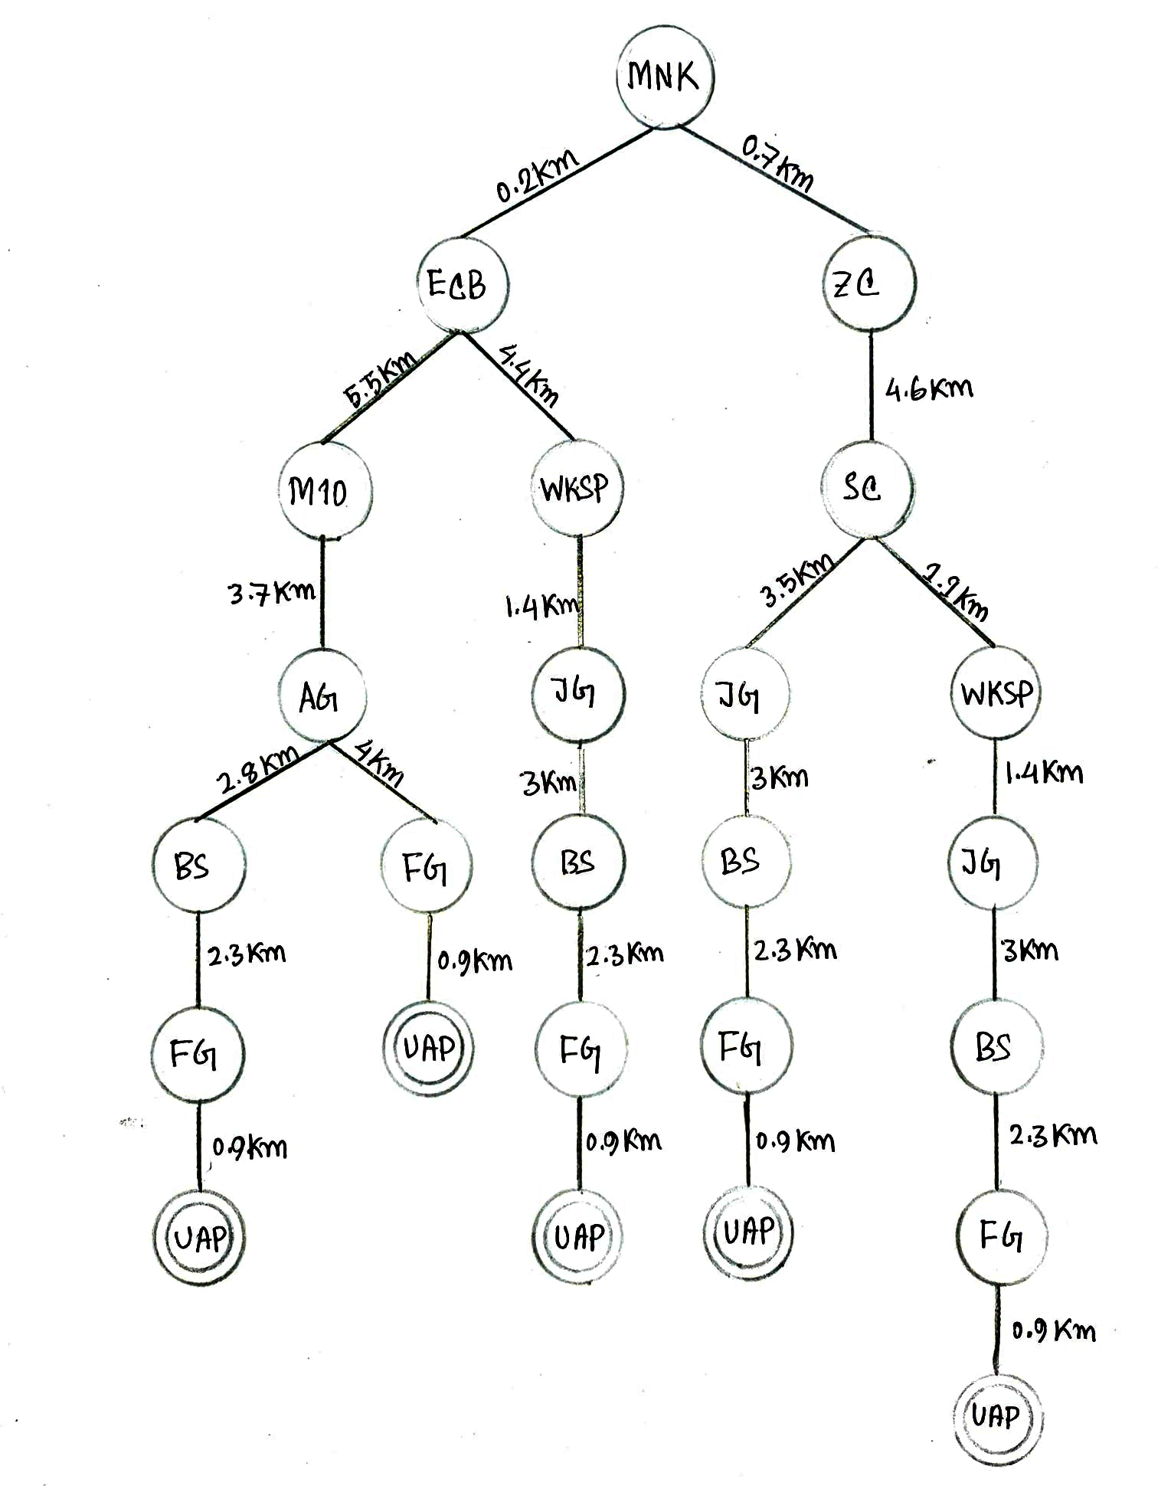
SEARCH TREE

Slide 7

IMPLEMENTATION

Slide 8
RESULT ANALYSIS
From the Map Shortest Path is :
Manikdi => ECB Chattar => Workshop Bus Stand => Jahangir Gate => Bijoy Sharani => Farmgate => University of Asia Pacific
Output from Implementation:

Slide 9
conclusion
Shortest Path for Start location to Destination location in this Map is Completely same with our Output of Implementation. So, that we can say we use this program for getting optimal path in any given map.

Slide 10
References
https://en.wikipedia.org/wiki/A*_search_algorithm
https://docs.python.org

Slide 11

THANK YOU

